Slide 1

Remembrance Day Assembly 2025
École 100 Mile Elementary
Honoring veterans and remembering their sacrifices
Notes:
---

Slide 2
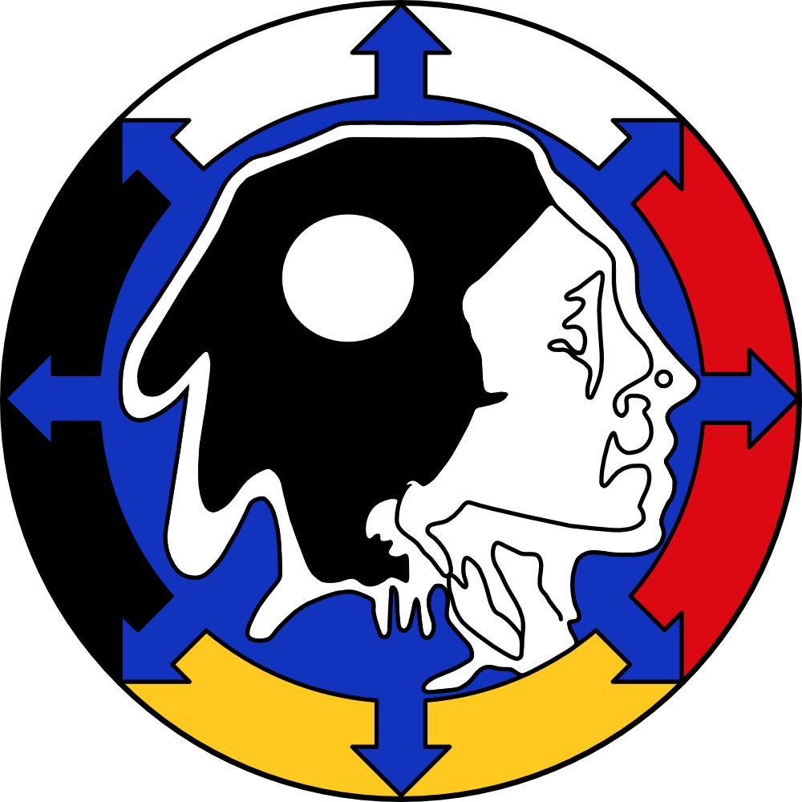
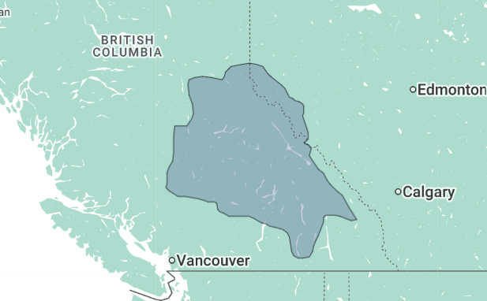
Traditional and Unceded Ancestral Territory
Secwepemcúl’ecw (Secwépemc)
Notes:
---

Slide 3
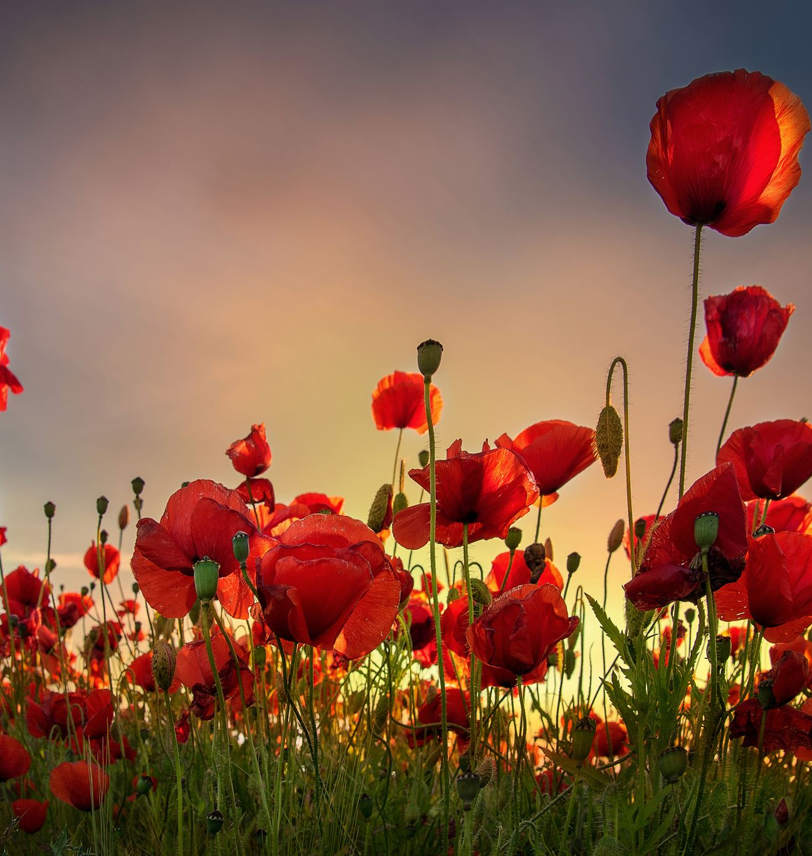
Introduction
Purpose of Assembly
  This assembly honors the brave men and women who served and sacrificed for Canada’s freedoms and values.
Reflection and Gratitude
  The occasion encourages reflection on courage and expresses gratitude to veterans and active service members.
Community Unity
  Remembrance Day brings the community together in unity to remember the fallen and inspire future generations.
Notes:
Welcome to our Remembrance Day Assembly. Today, we gather as a community to pay tribute to the brave men and women who have served and sacrificed for Canada. This solemn occasion provides an opportunity to reflect on the courage, dedication, and selflessness of those who have defended our freedoms and values. It is a time to come together in unity, to remember the fallen, and to express our gratitude to veterans and active service members. Through this assembly, we aim to educate, honor, and inspire, ensuring that the legacy of our heroes lives on in our hearts and minds.

Slide 4
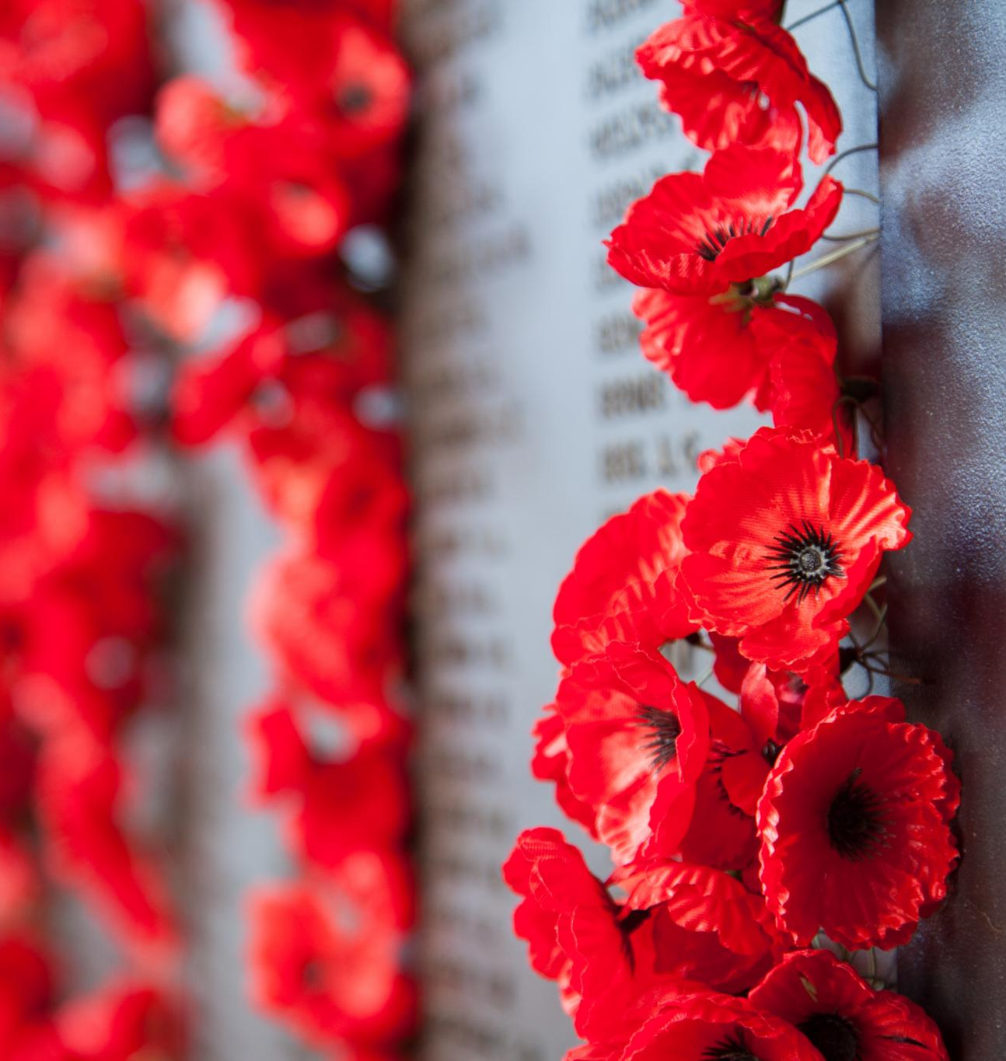
History of Remembrance Day
Origin and Significance
  Remembrance Day marks the 1918 armistice ending World War I and honors all military service members since then.
Evolution of Observance
  Originally Armistice Day, it evolved to honor veterans of multiple conflicts including World War II and Korea.
Traditions and Activities
  Ceremonies include poem recitations, moments of silence, and community participation emphasizing remembrance.
Notes:
Remembrance Day is observed annually on November 11th to mark the armistice that ended World War I in 1918. Originally known as Armistice Day, it was first commemorated in 1919 and later renamed to Remembrance Day to honor all military personnel who have served in wars and peacekeeping missions. The date holds historical significance as it symbolizes the cessation of hostilities on the Western Front of World War I. Over the years, Remembrance Day has evolved to include tributes to those who served in World War II, the Korean War, Afghanistan, and other conflicts. Ceremonies across Canada feature the laying of wreaths, recitation of the poem 'In Flanders Fields,' and moments of silence. Schools, communities, and government institutions participate in events that emphasize the importance of remembering the sacrifices made for peace and freedom.

Slide 5
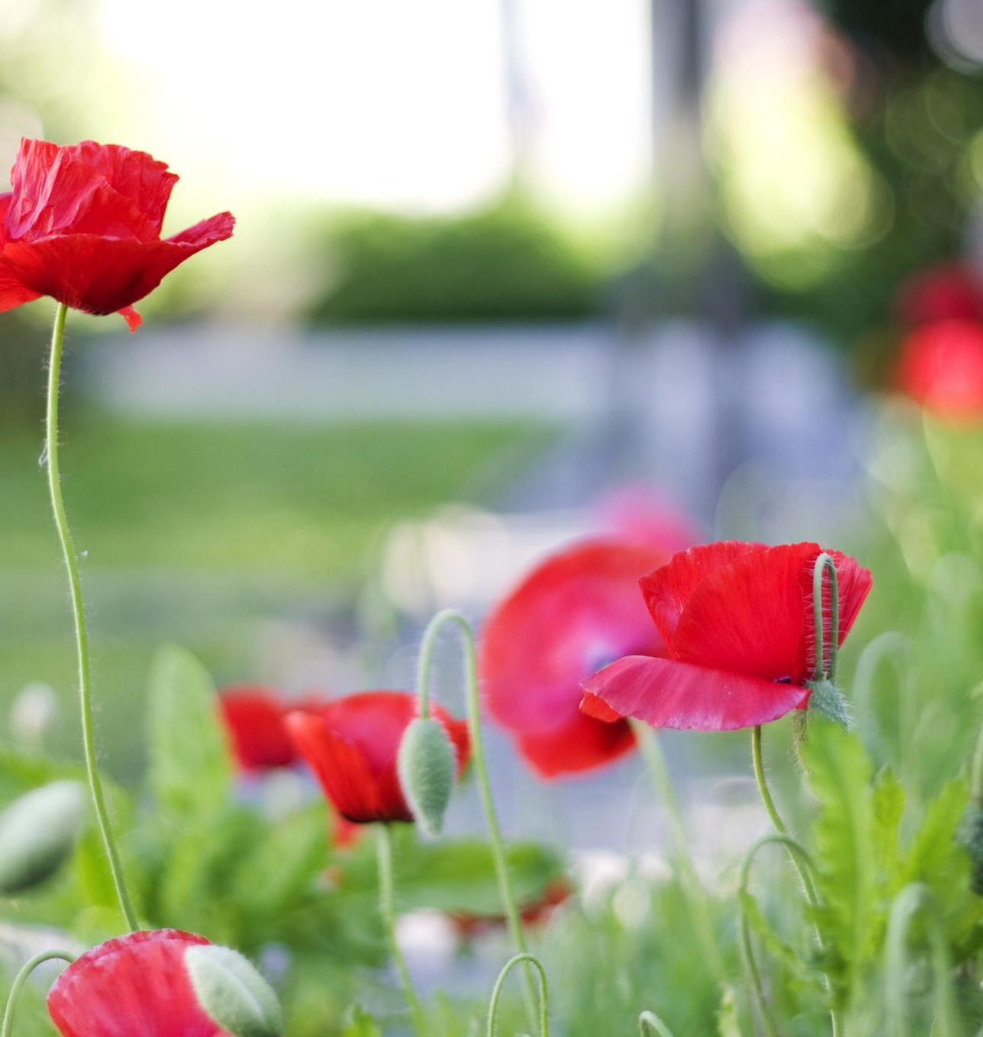
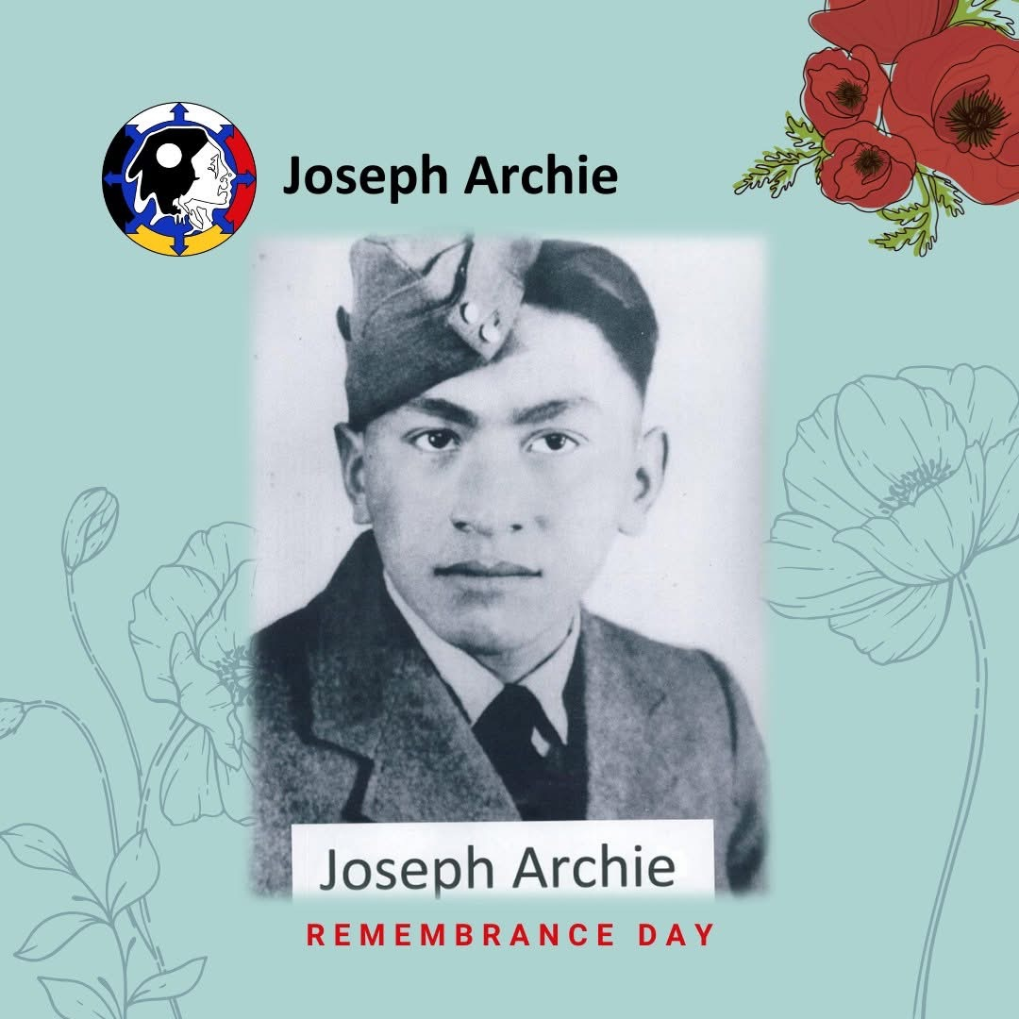
National Indigenous Veterans Day – November 8th
On this day we honour the many First Nations, Métis, and Inuit soldiers who served Canada, even when they did not have equal rights.
Many of these courageous men and women faced extra challenges: they had to travel far from home, learn a different language, adapt to a new way of life, and overcome discrimination.
Notes:
The red poppy has become an enduring symbol of Remembrance Day in Canada and other Commonwealth nations. Its significance stems from the World War I poem 'In Flanders Fields' by Lieutenant Colonel John McCrae, which describes poppies growing among soldiers' graves in Belgium. The poppy represents the blood shed by soldiers and serves as a visual reminder of their sacrifice. Canadians wear poppies on their lapels in the weeks leading up to November 11th to show respect and support for veterans. The Royal Canadian Legion distributes millions of poppies each year, with donations supporting veterans and their families. The act of wearing a poppy is a personal and collective gesture of remembrance, ensuring that the stories and contributions of those who served are never forgotten.

Slide 6
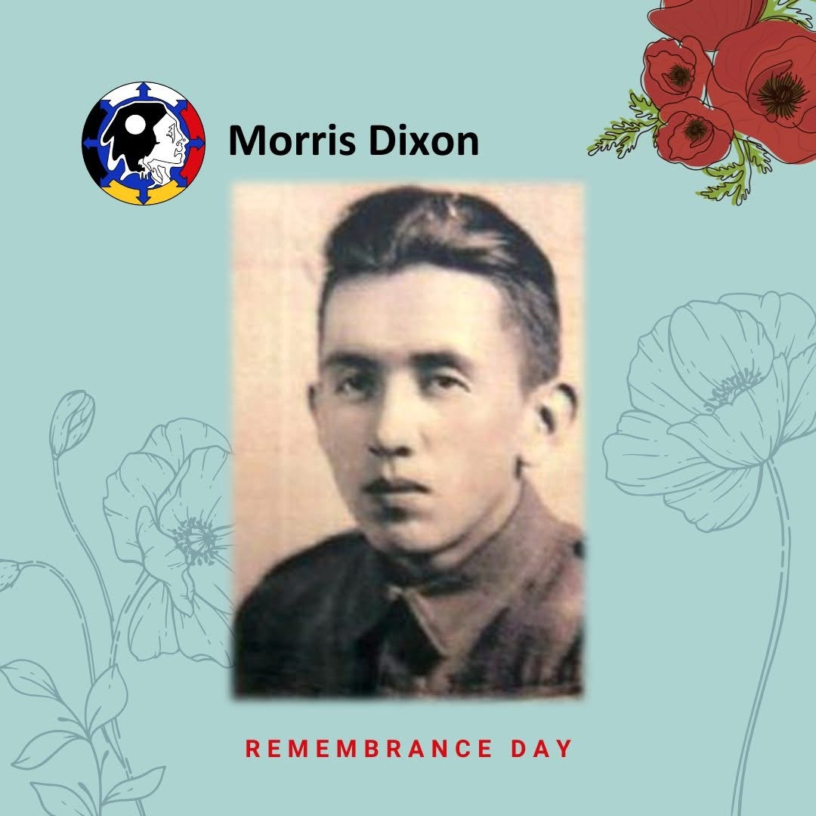
Indigenous people have been part of Canada’s military history for more than 200 years.
They served in the First and Second World Wars, the Korean War, and peace-keeping missions.
Some were “Code Talkers” — they used their Indigenous languages to send secret messages so that enemies couldn’t understand.
Notes:
The red poppy has become an enduring symbol of Remembrance Day in Canada and other Commonwealth nations. Its significance stems from the World War I poem 'In Flanders Fields' by Lieutenant Colonel John McCrae, which describes poppies growing among soldiers' graves in Belgium. The poppy represents the blood shed by soldiers and serves as a visual reminder of their sacrifice. Canadians wear poppies on their lapels in the weeks leading up to November 11th to show respect and support for veterans. The Royal Canadian Legion distributes millions of poppies each year, with donations supporting veterans and their families. The act of wearing a poppy is a personal and collective gesture of remembrance, ensuring that the stories and contributions of those who served are never forgotten.

Slide 7
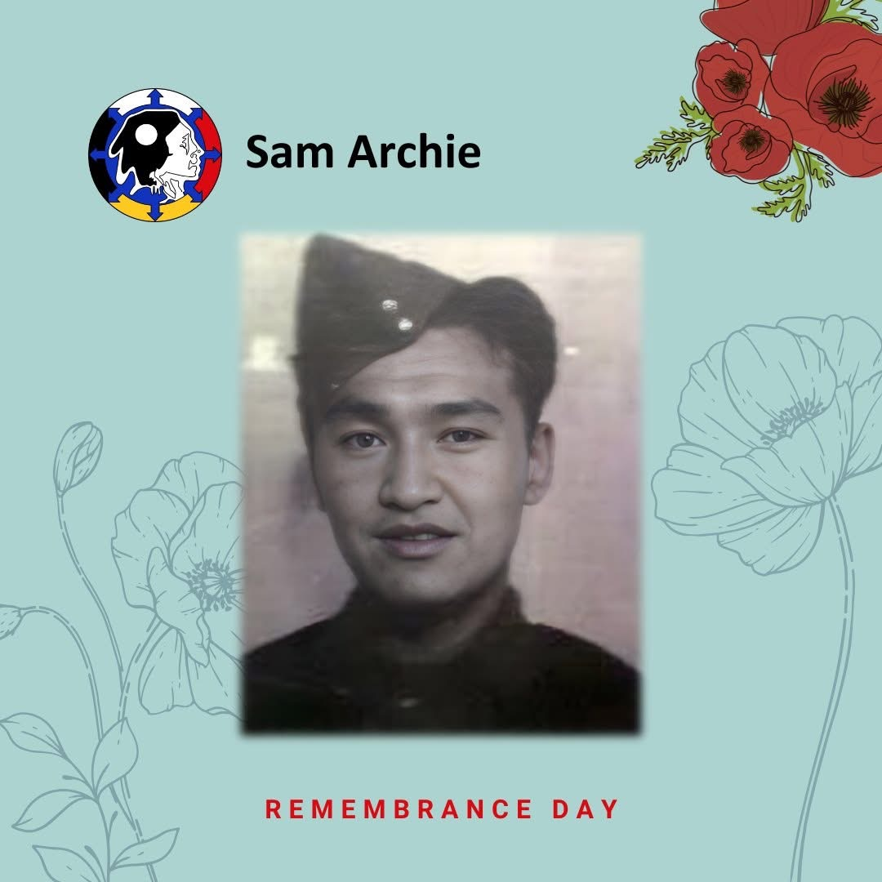
After the war, many Indigenous veterans did not receive the same benefits or recognition as others.
Today we remember their courage, honour their legacy, and learn from their stories.
You can show respect by wearing a poppy, listening to a story of an Indigenous veteran, or simply saying “Thank you for your service.
Notes:
The red poppy has become an enduring symbol of Remembrance Day in Canada and other Commonwealth nations. Its significance stems from the World War I poem 'In Flanders Fields' by Lieutenant Colonel John McCrae, which describes poppies growing among soldiers' graves in Belgium. The poppy represents the blood shed by soldiers and serves as a visual reminder of their sacrifice. Canadians wear poppies on their lapels in the weeks leading up to November 11th to show respect and support for veterans. The Royal Canadian Legion distributes millions of poppies each year, with donations supporting veterans and their families. The act of wearing a poppy is a personal and collective gesture of remembrance, ensuring that the stories and contributions of those who served are never forgotten.

Slide 8
Significance of the Poppy
Symbolism of the Red Poppy
  The red poppy symbolizes blood shed by soldiers and is a powerful visual reminder of sacrifice during war.
Origin from 'In Flanders Fields'
  The poppy gained significance from the WWI poem 'In Flanders Fields' depicting poppies among soldiers' graves.
Remembrance Day Tradition
  Canadians wear poppies before November 11th to honor veterans and support their families through donations.
Notes:
The red poppy has become an enduring symbol of Remembrance Day in Canada and other Commonwealth nations. Its significance stems from the World War I poem 'In Flanders Fields' by Lieutenant Colonel John McCrae, which describes poppies growing among soldiers' graves in Belgium. The poppy represents the blood shed by soldiers and serves as a visual reminder of their sacrifice. Canadians wear poppies on their lapels in the weeks leading up to November 11th to show respect and support for veterans. The Royal Canadian Legion distributes millions of poppies each year, with donations supporting veterans and their families. The act of wearing a poppy is a personal and collective gesture of remembrance, ensuring that the stories and contributions of those who served are never forgotten.

Slide 9
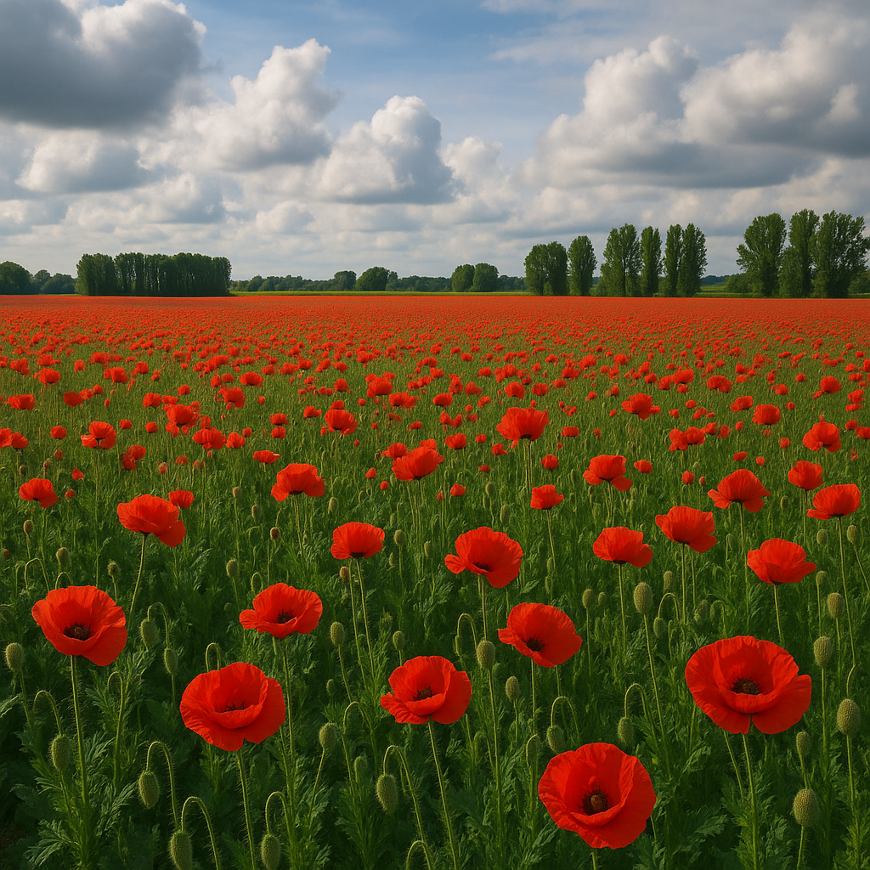

In Flander’s Fields

Slide 10
Moment of Silence
Significance of the Moment
The moment of silence commemorates the armistice time ending World War I at 11:00 a.m. on November 11th, 1918.
Purpose of Reflection
This pause allows individuals to honor soldiers’ sacrifices and express collective gratitude and sorrow silently.
Community Participation
Schools, workplaces, and public gatherings across Canada observe the moment, promoting shared respect and remembrance.
Notes:
A moment of silence is a central element of Remembrance Day ceremonies, observed at 11:00 a.m. on November 11th. This tradition honors the exact time when the armistice took effect in 1918, ending World War I. During this pause, individuals reflect on the sacrifices made by soldiers and contemplate the cost of war. The silence is a powerful and respectful way to express gratitude and sorrow, allowing participants to connect emotionally with the legacy of those who served. Schools, workplaces, and public gatherings across Canada participate in this observance, reinforcing the collective commitment to remembering and honoring the fallen. The moment of silence transcends words, serving as a universal gesture of respect and remembrance.

Slide 11
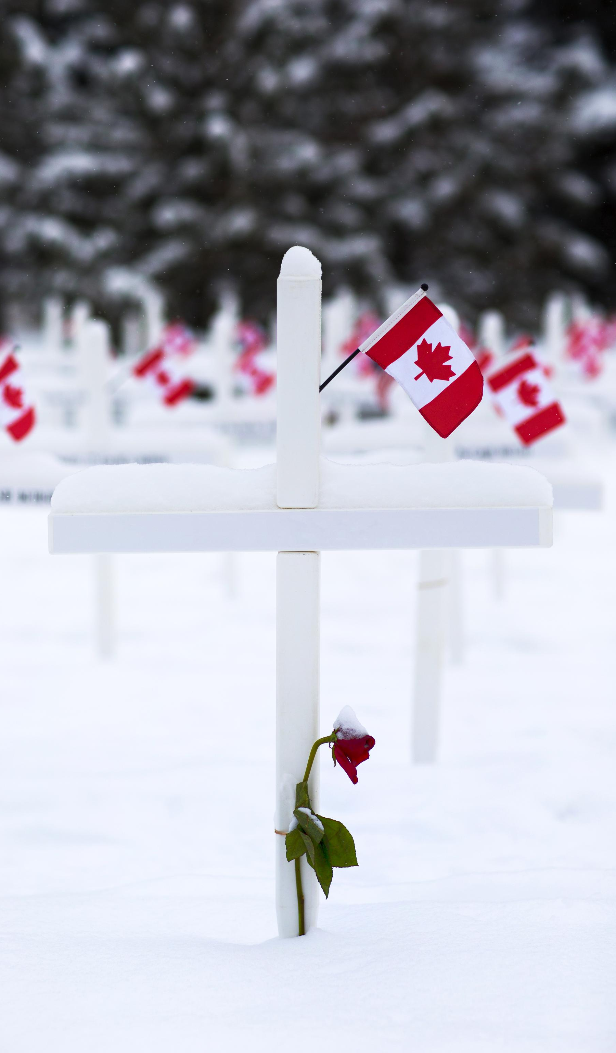
Honoring Veterans
Veterans' Service and Sacrifice
  Veterans served in the Canadian Armed Forces, risking their lives to protect the nation and uphold its freedoms.
Community Tributes and Ceremonies
  Communities honor veterans on Remembrance Day through ceremonies, parades, and personal tributes expressing appreciation.
Support and Recognition Organizations
  Organizations like the Royal Canadian Legion host events and provide support services to recognize and assist veterans.
Ongoing Needs of Veterans
  Honoring veterans includes acknowledging their healthcare, housing, and mental health needs for continued well-being.
Notes:
Honoring veterans is a fundamental aspect of Remembrance Day in Canada. Veterans are individuals who have served in the Canadian Armed Forces, often enduring great hardship and risking their lives to protect the nation. On this day, communities express their appreciation through ceremonies, parades, and personal tributes. Schools may invite veterans to speak about their experiences, fostering understanding and empathy among students. The Royal Canadian Legion and other organizations host events to recognize the contributions of veterans and provide support services. Honoring veterans also involves acknowledging their ongoing needs, including healthcare, housing, and mental health support. By celebrating their courage and dedication, Canadians reaffirm their commitment to those who have defended their freedoms and uphold the values of peace and democracy.

Slide 12
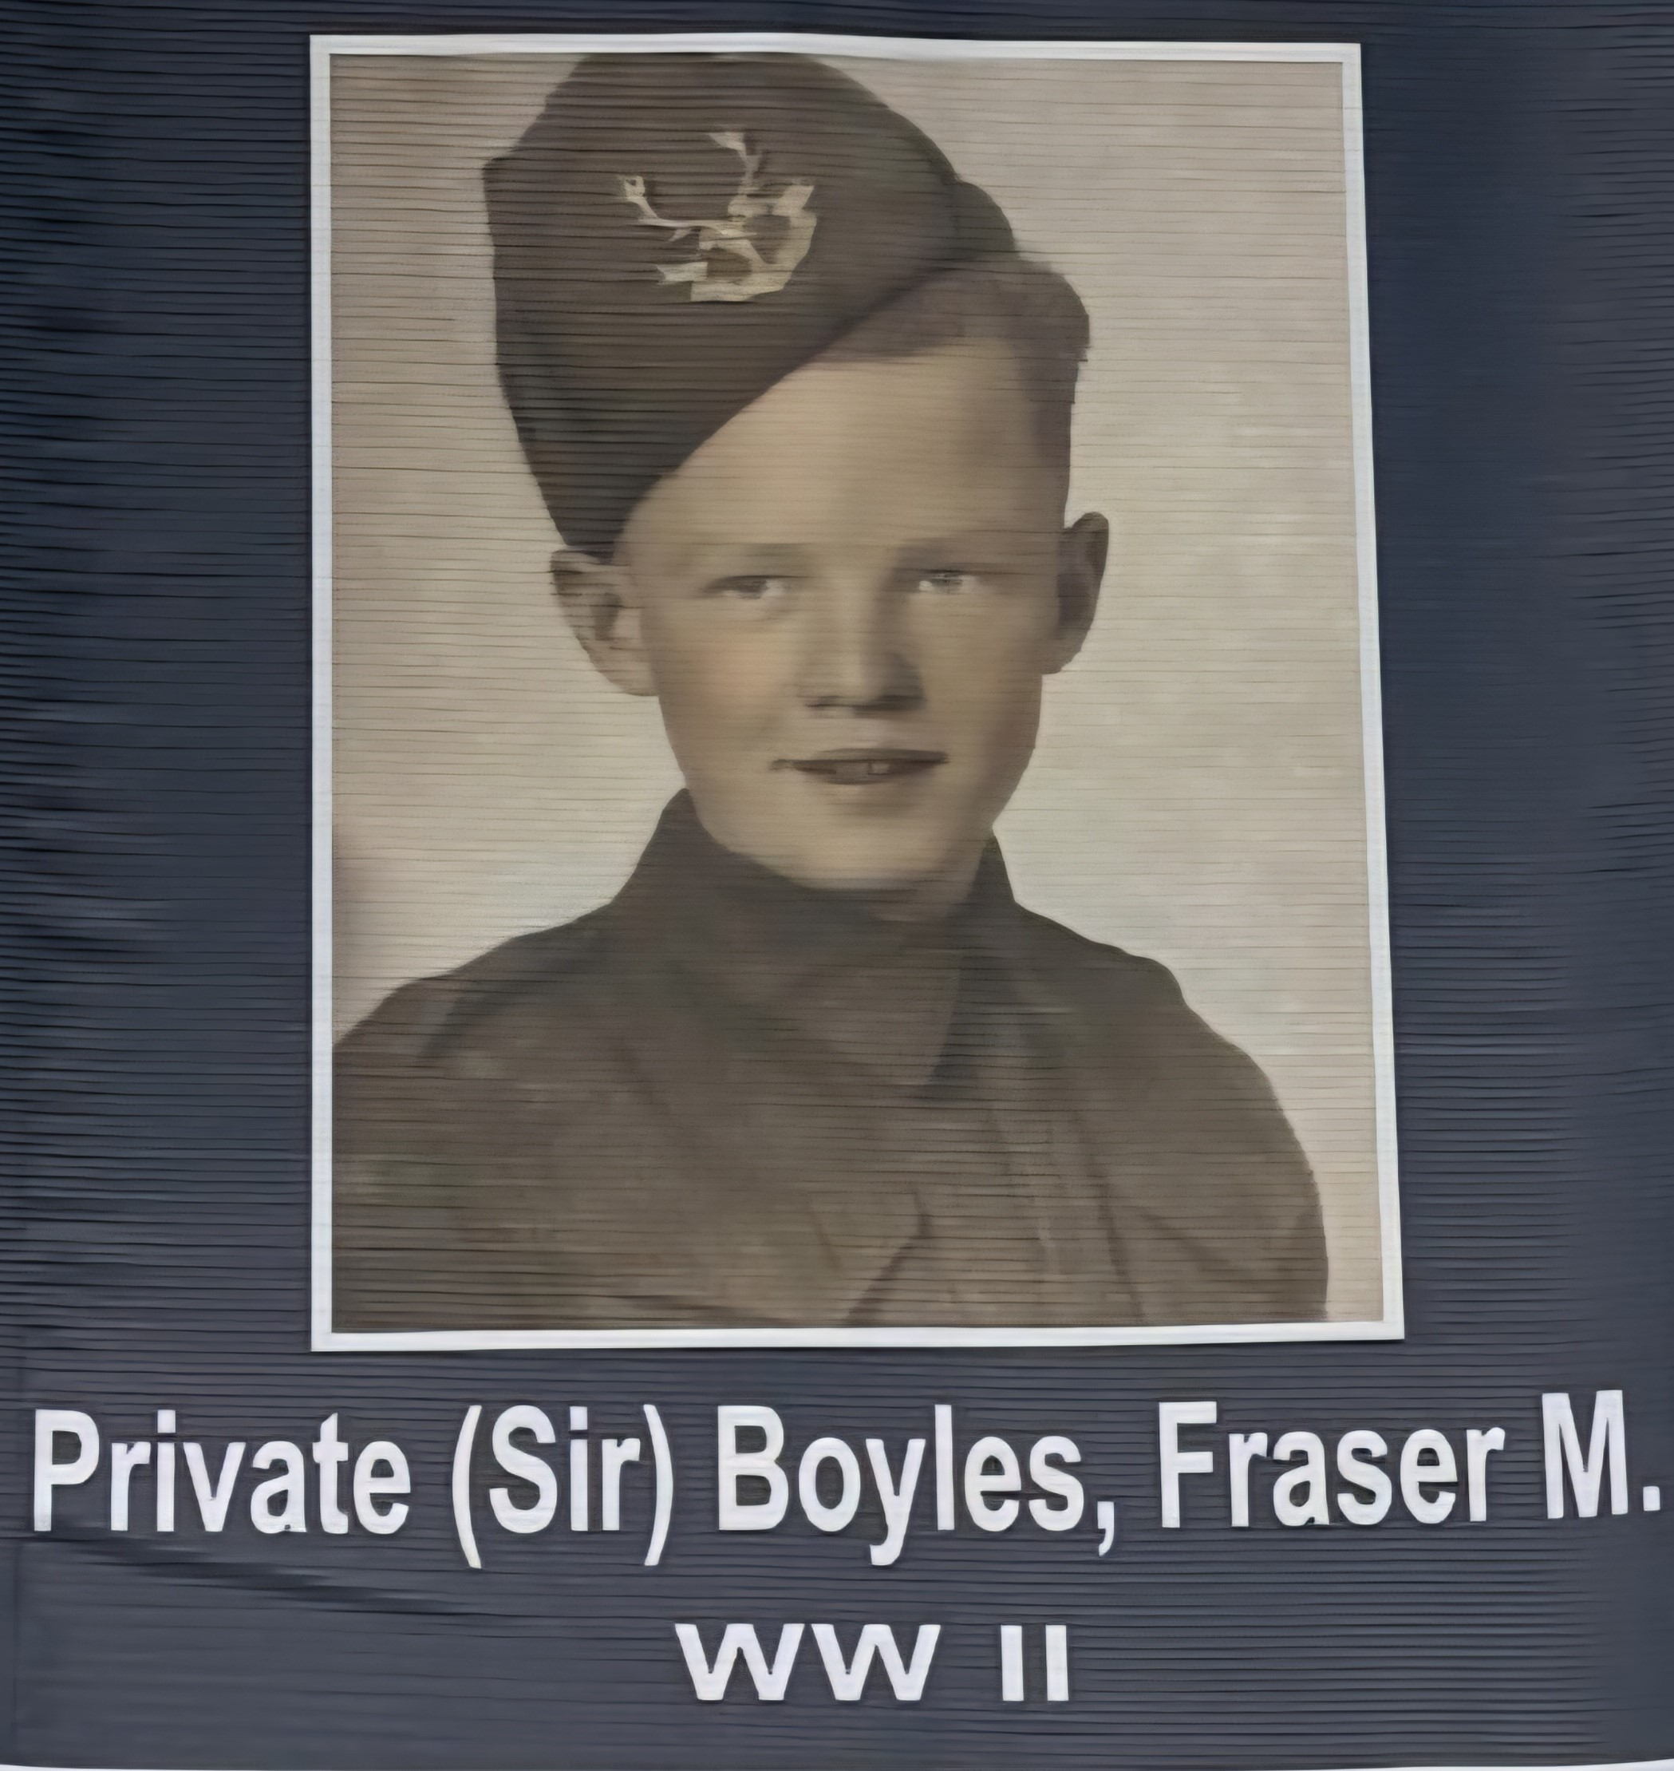
Grandfather of
Frankie, Charlie, and Casey Baboulas
Notes:
Remembrance Day is observed annually on November 11th to mark the armistice that ended World War I in 1918. Originally known as Armistice Day, it was first commemorated in 1919 and later renamed to Remembrance Day to honor all military personnel who have served in wars and peacekeeping missions. The date holds historical significance as it symbolizes the cessation of hostilities on the Western Front of World War I. Over the years, Remembrance Day has evolved to include tributes to those who served in World War II, the Korean War, Afghanistan, and other conflicts. Ceremonies across Canada feature the laying of wreaths, recitation of the poem 'In Flanders Fields,' and moments of silence. Schools, communities, and government institutions participate in events that emphasize the importance of remembering the sacrifices made for peace and freedom.

Slide 13
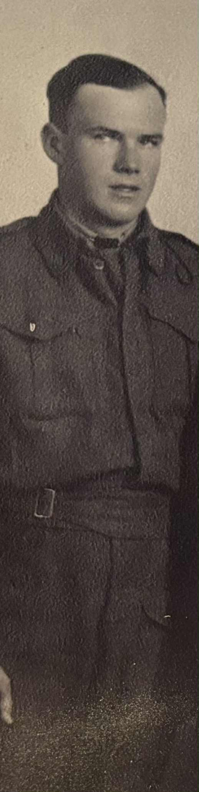
Private Allan Riddell
WWII 1942 – 1945
Great Grandfather to
Oden & Kallie Hall
Notes:
Remembrance Day is observed annually on November 11th to mark the armistice that ended World War I in 1918. Originally known as Armistice Day, it was first commemorated in 1919 and later renamed to Remembrance Day to honor all military personnel who have served in wars and peacekeeping missions. The date holds historical significance as it symbolizes the cessation of hostilities on the Western Front of World War I. Over the years, Remembrance Day has evolved to include tributes to those who served in World War II, the Korean War, Afghanistan, and other conflicts. Ceremonies across Canada feature the laying of wreaths, recitation of the poem 'In Flanders Fields,' and moments of silence. Schools, communities, and government institutions participate in events that emphasize the importance of remembering the sacrifices made for peace and freedom.

Slide 14
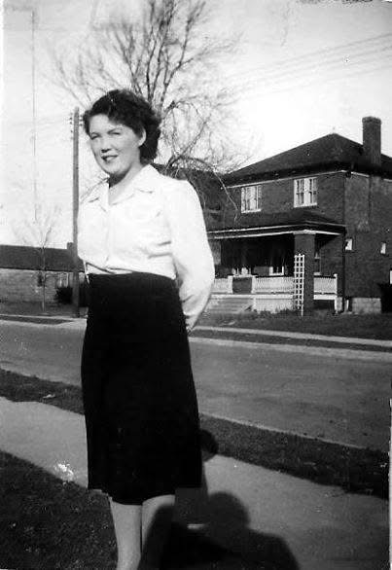
Private Marjorie Jackson
Served 1943 -1945
Great Grandmother to
Max Weber
Notes:
Remembrance Day is observed annually on November 11th to mark the armistice that ended World War I in 1918. Originally known as Armistice Day, it was first commemorated in 1919 and later renamed to Remembrance Day to honor all military personnel who have served in wars and peacekeeping missions. The date holds historical significance as it symbolizes the cessation of hostilities on the Western Front of World War I. Over the years, Remembrance Day has evolved to include tributes to those who served in World War II, the Korean War, Afghanistan, and other conflicts. Ceremonies across Canada feature the laying of wreaths, recitation of the poem 'In Flanders Fields,' and moments of silence. Schools, communities, and government institutions participate in events that emphasize the importance of remembering the sacrifices made for peace and freedom.

Slide 15
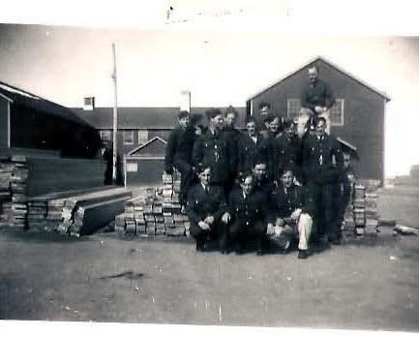
Private Jack Hill
Served 1942 -1945
Great Grandfather to
Max Weber
Notes:
Remembrance Day is observed annually on November 11th to mark the armistice that ended World War I in 1918. Originally known as Armistice Day, it was first commemorated in 1919 and later renamed to Remembrance Day to honor all military personnel who have served in wars and peacekeeping missions. The date holds historical significance as it symbolizes the cessation of hostilities on the Western Front of World War I. Over the years, Remembrance Day has evolved to include tributes to those who served in World War II, the Korean War, Afghanistan, and other conflicts. Ceremonies across Canada feature the laying of wreaths, recitation of the poem 'In Flanders Fields,' and moments of silence. Schools, communities, and government institutions participate in events that emphasize the importance of remembering the sacrifices made for peace and freedom.

Slide 16
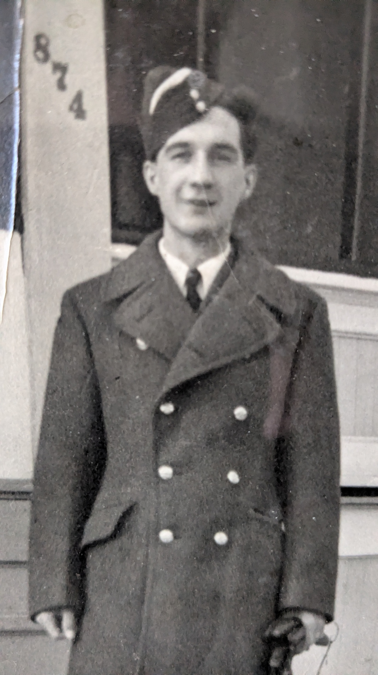
Allen Ellerback
Great Great Grandfather to Nevi Bradshaw
Notes:
Remembrance Day is observed annually on November 11th to mark the armistice that ended World War I in 1918. Originally known as Armistice Day, it was first commemorated in 1919 and later renamed to Remembrance Day to honor all military personnel who have served in wars and peacekeeping missions. The date holds historical significance as it symbolizes the cessation of hostilities on the Western Front of World War I. Over the years, Remembrance Day has evolved to include tributes to those who served in World War II, the Korean War, Afghanistan, and other conflicts. Ceremonies across Canada feature the laying of wreaths, recitation of the poem 'In Flanders Fields,' and moments of silence. Schools, communities, and government institutions participate in events that emphasize the importance of remembering the sacrifices made for peace and freedom.

Slide 17
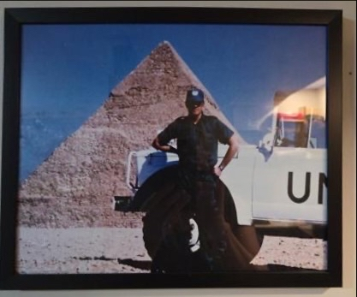
Sargeant Serge Dumont
Grandfather to
Grace & Lily
Father to
Mrs Simcox
Notes:
Remembrance Day is observed annually on November 11th to mark the armistice that ended World War I in 1918. Originally known as Armistice Day, it was first commemorated in 1919 and later renamed to Remembrance Day to honor all military personnel who have served in wars and peacekeeping missions. The date holds historical significance as it symbolizes the cessation of hostilities on the Western Front of World War I. Over the years, Remembrance Day has evolved to include tributes to those who served in World War II, the Korean War, Afghanistan, and other conflicts. Ceremonies across Canada feature the laying of wreaths, recitation of the poem 'In Flanders Fields,' and moments of silence. Schools, communities, and government institutions participate in events that emphasize the importance of remembering the sacrifices made for peace and freedom.

Slide 18
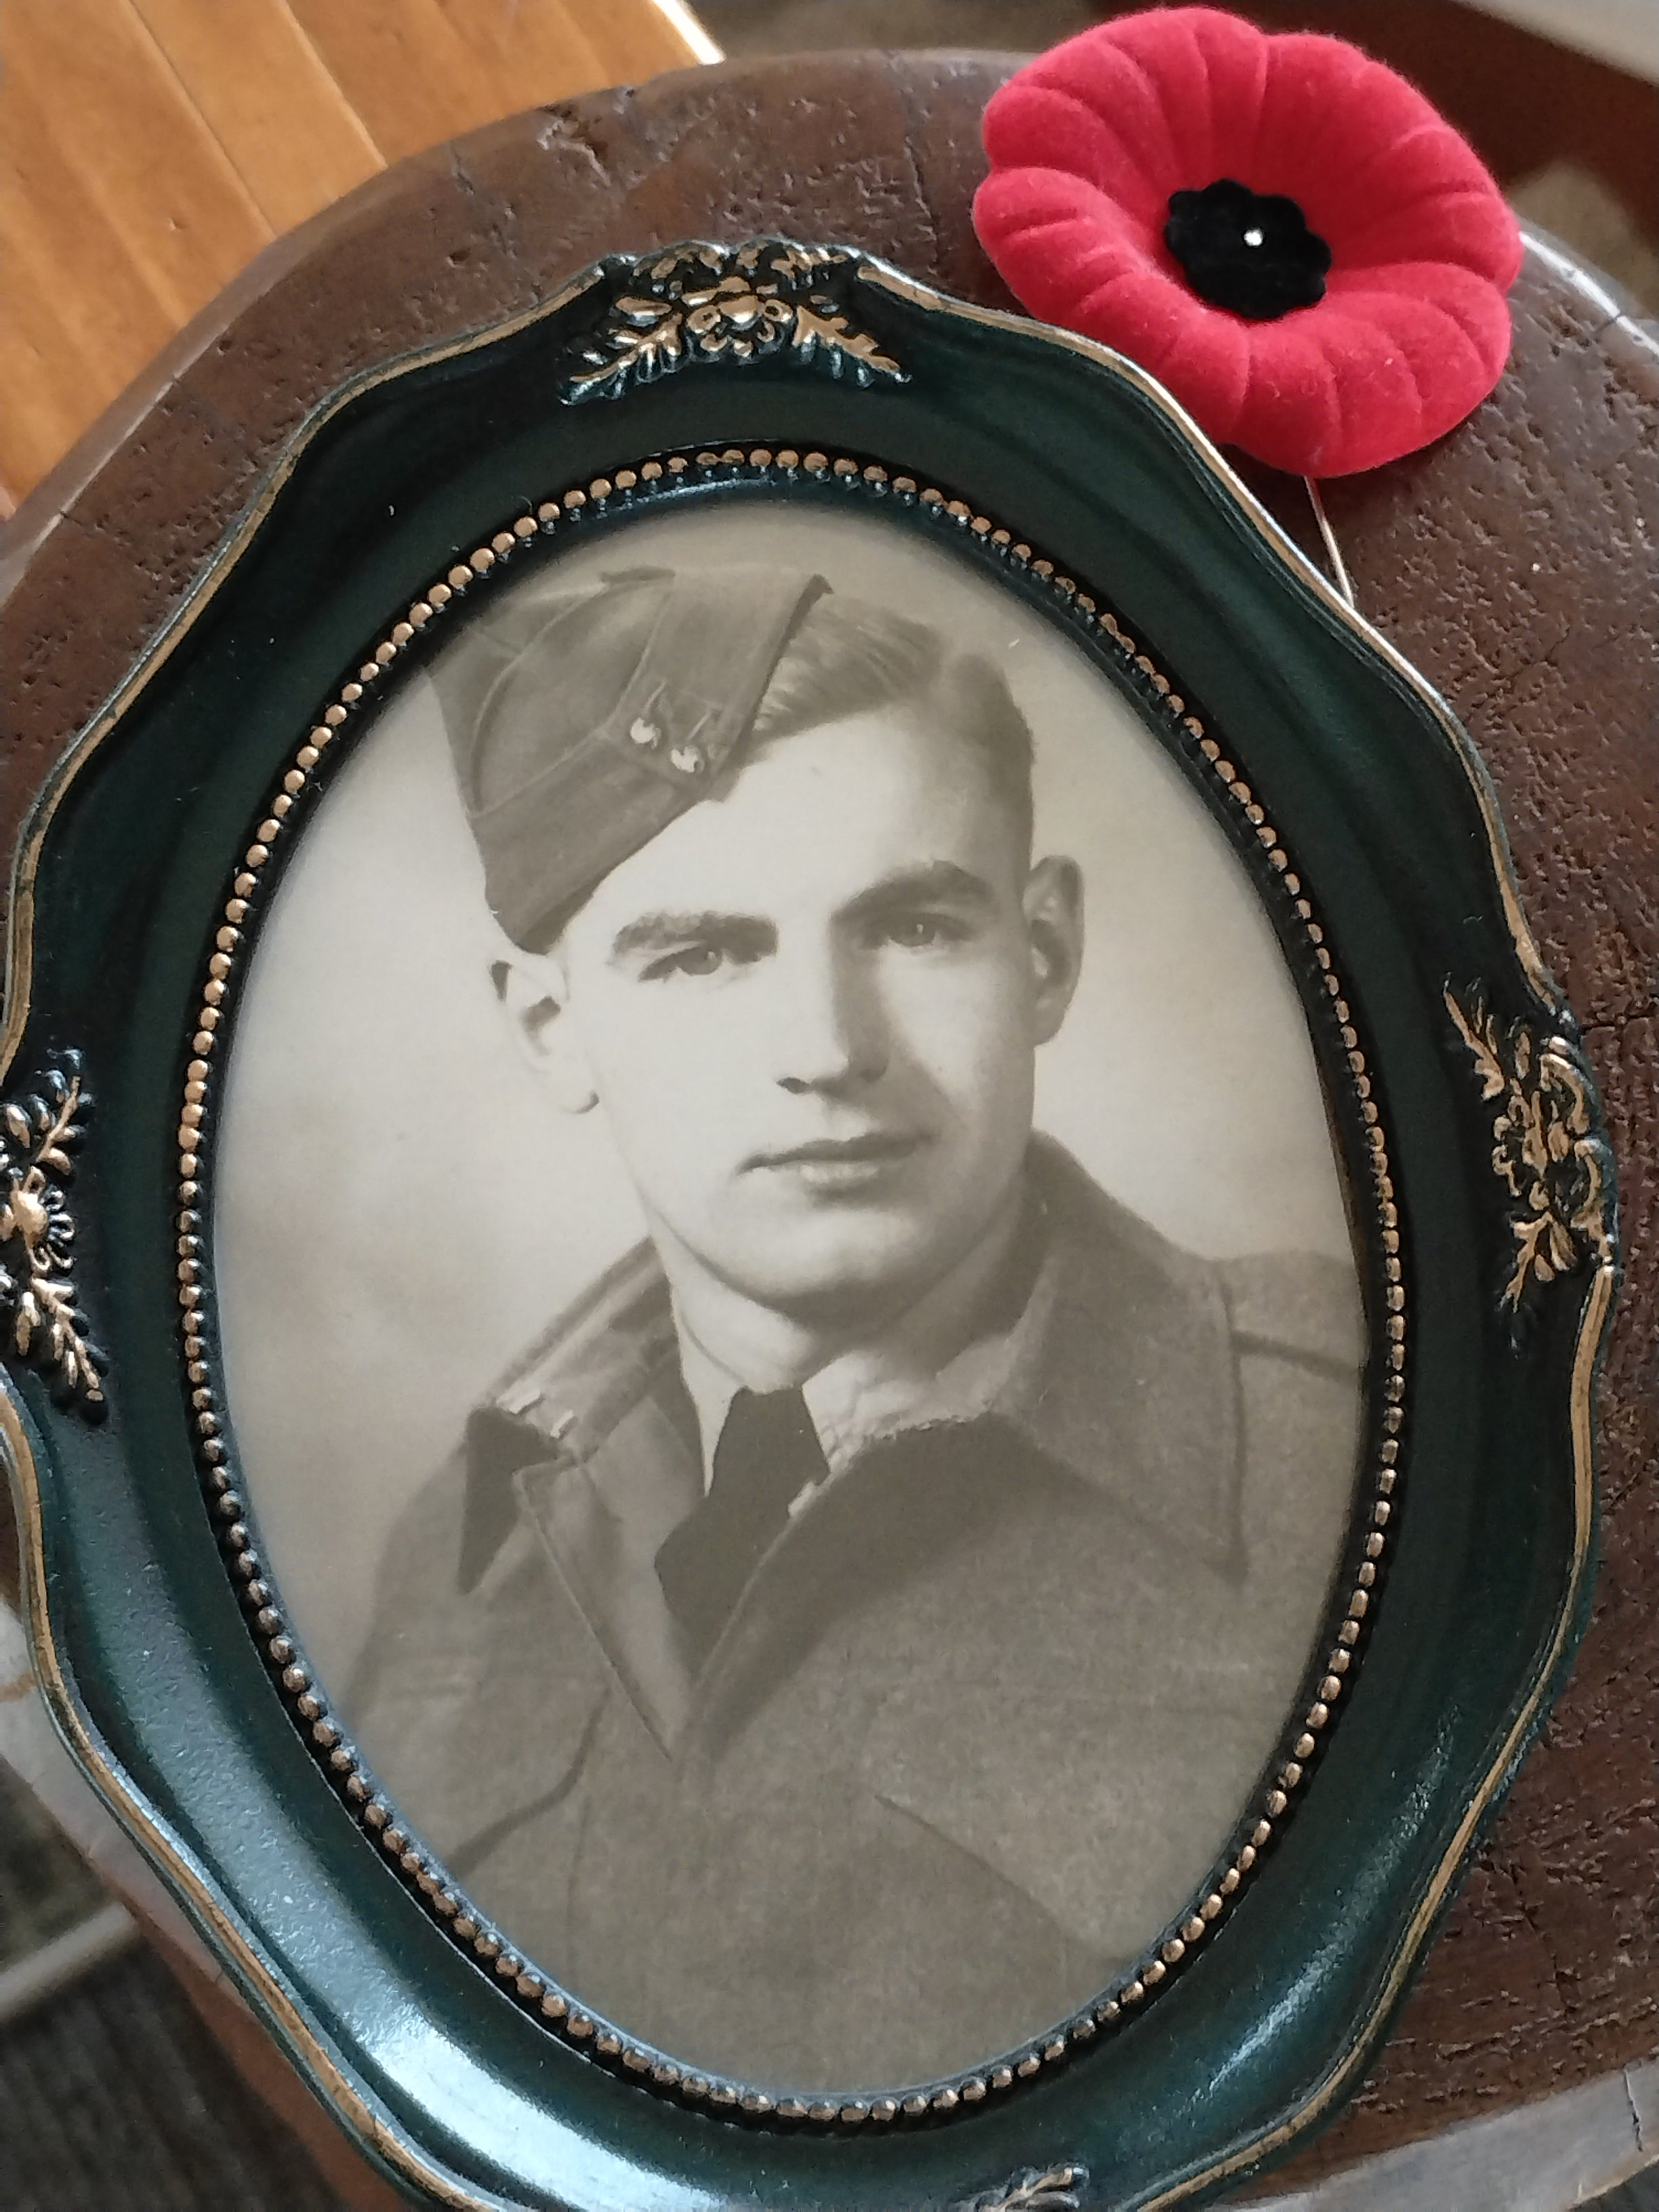
Edward George Pincott
Served in Germany and Holland
Great Grandfather to Rylan & Karter Pincott
Notes:
Remembrance Day is observed annually on November 11th to mark the armistice that ended World War I in 1918. Originally known as Armistice Day, it was first commemorated in 1919 and later renamed to Remembrance Day to honor all military personnel who have served in wars and peacekeeping missions. The date holds historical significance as it symbolizes the cessation of hostilities on the Western Front of World War I. Over the years, Remembrance Day has evolved to include tributes to those who served in World War II, the Korean War, Afghanistan, and other conflicts. Ceremonies across Canada feature the laying of wreaths, recitation of the poem 'In Flanders Fields,' and moments of silence. Schools, communities, and government institutions participate in events that emphasize the importance of remembering the sacrifices made for peace and freedom.

Slide 19
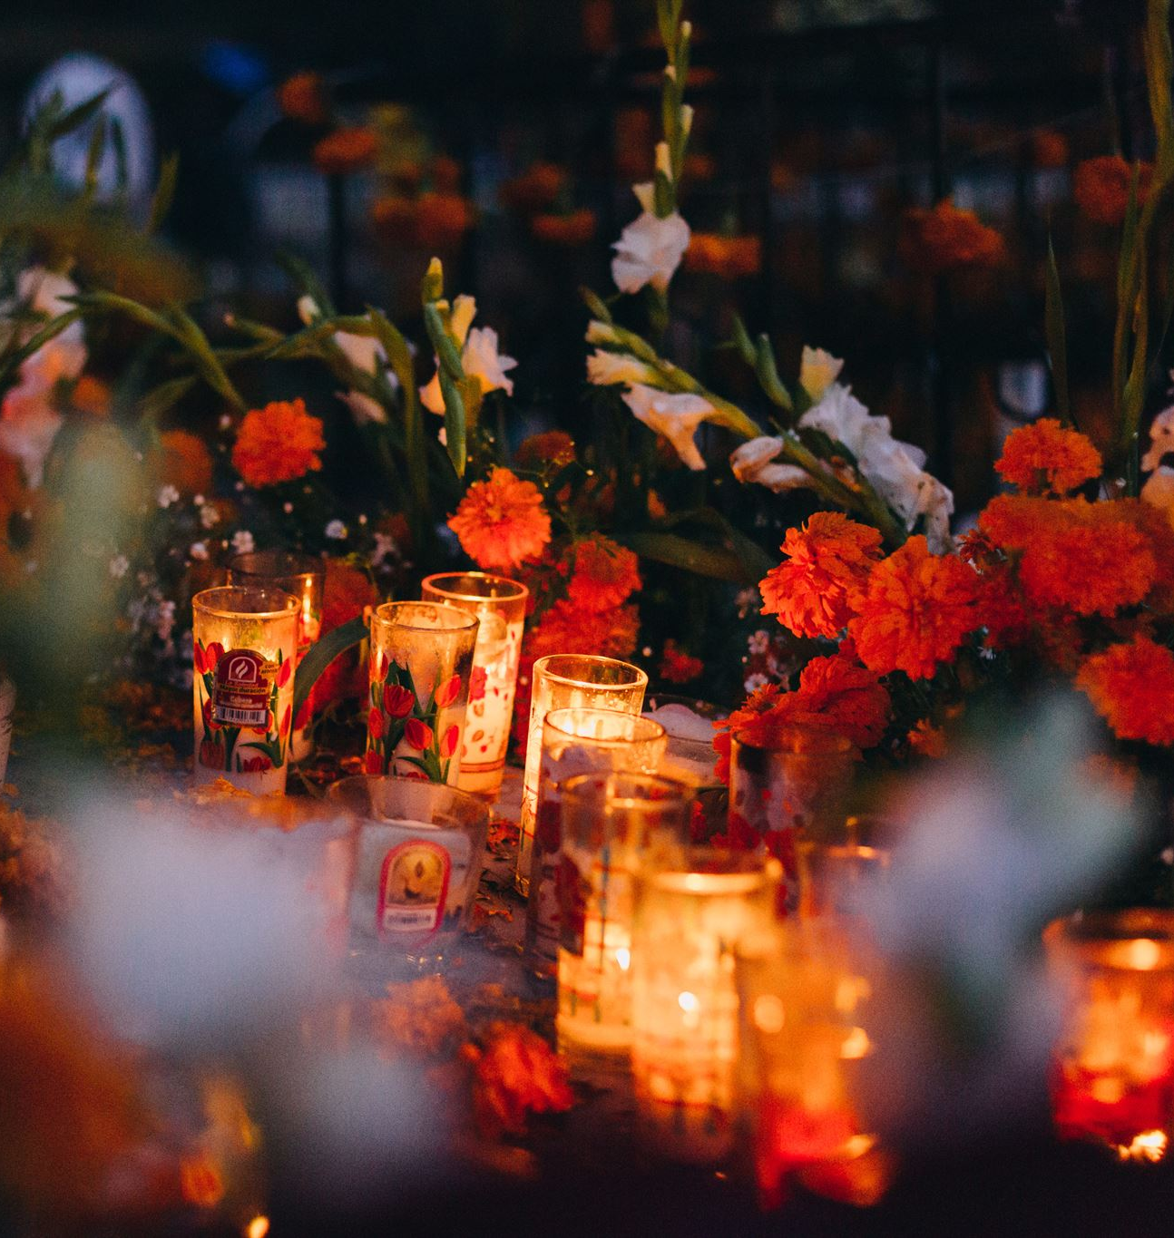
Closing Remarks
Honoring Veterans and Fallen
  Remember and honor the sacrifices of veterans and fallen soldiers who secured our freedoms.
Importance of Remembrance
  Commit to remembering not only on November 11th but every day to preserve history and peace.
Living with Compassion
  Let the assembly inspire compassion, respect, and gratitude for those who served and sacrificed.
Notes:
Thank you for joining us in this solemn tribute during our Remembrance Day Assembly. As we conclude, let us carry forward the lessons of history and the spirit of gratitude. The sacrifices of our veterans and fallen soldiers have shaped the freedoms we enjoy today, and it is our duty to remember and honor them not just on November 11th, but every day. Let us continue to educate future generations about the importance of peace, service, and remembrance. May this assembly inspire us to live with compassion, respect, and a deep appreciation for those who have given so much for our country.

